Slide 1




Dr. Prosper Nkurunziza
FACTORS OF ADOPTION OF MAIZE POST HARVEST TECHNOLOGIES AMONG FARMER COOPERATIVE MEMBERS in KIREHE DISTRICT, RWANDA

Slide 2
Introduction
Postharvest technologies are very important in proper handling of food products. (Kitinoja, 2015).
In developing countries, 30% of harvested grain is lost due to inadequate postharvest handling and storage (Hodges and Tanya, 2012).

Slide 3
Introduction Cont.
Low level of adoption of postharvest technologies has caused many negative effects. (Mohammad, 2010).
PHHS was established by the MINAGRI to address loss loss and related issues

Slide 4
Introduction Cont.
Reduction of maize loss from 32% to 9.24% in 2013. (Kayiranga, 2013)
There is significant positive change at national level but there is lack of documented on the same in Kirehe District.

Slide 5
Objectives of the study
Describe personal and institutional factors of adoption
Find out the level of adoption of maize postharvest technologies among maize farmers in Kirehe District
Establish a relationship between factors and adoption of maize postharvest technologies

Slide 6
Methodology
Correlational, and descriptive, research designs
A sample of 385 maize farmers
Data collection: semi-structured questionnaire and validated Key Informants Interview (KII).

Slide 7
Results and Discussion
Average age is 43, 96.8% are married, Average years of schooling 5.8
82.8% are land lords and farming for food first and for the market
Average number training (4.59) and coaching (1.78), Average years of experience (5)
Average number of fixed asset (3)

Slide 8
Results and Discussion Cont.
Reasons for joining cooperative: value addition, improving farm methods and linking to market.
Limited access to postharvest management technologies information
Farmers’ access to electricity (10.7%).
Farm distance from the road was 361.5 meters.
Collection centers

Slide 9
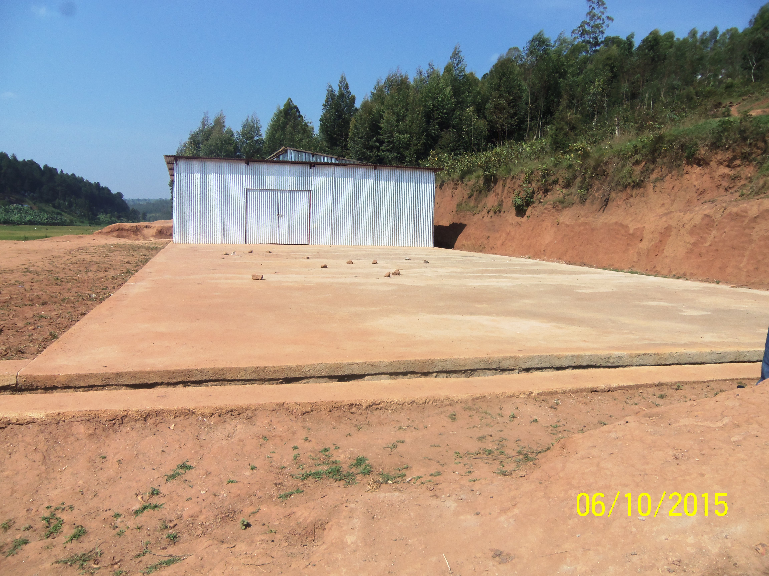
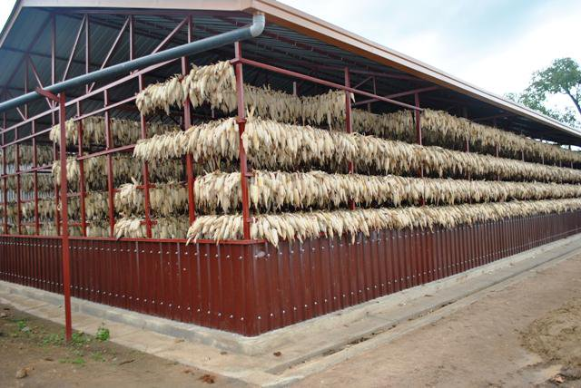
Adoption of technologies: Drying
77.1% are major adopters of cemented drying ground

Slide 10
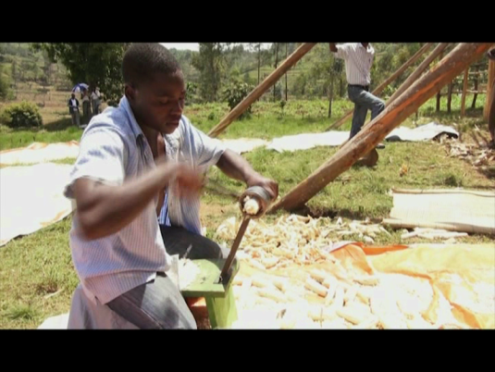
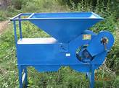
Adoption: Shelling and Winnowing
mechanical shelling machines (90.1%),
winnowing machine (45%)

Slide 11
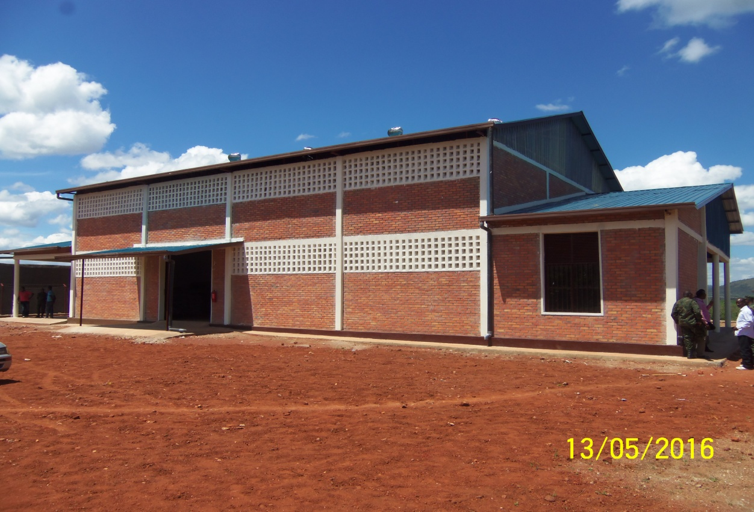
Adoption of Technology: Storage
96.8 are major adopters of warehouses
electrical shelling, electrical winnowing, metallic silos are lowly adopted in the study area

Slide 12
Relationship between factors and adoption
There is significant influence of personal factors and adoption
Age and electrical shelling machine, sieve and winnowing (b=-.360, P=.023*) (b=.68, P=006** )
education and cemented drying ground, drying shade, sheeting, mechanical shelling machine and shelling with hands, house floor sacks (b=2.38, P=005**)

Slide 13
Relationship between factors and adoption
size of family and shelling with hands (b=.952, P=.010**),
farming experience and winnowing machines and sieves
number of asset and concrete silos
access to information and electrical and mechanical shelling machine.

Slide 14
Conclusion and Recommendations
Conclusion
personal factors were determinants of the level of adoption of postharvest technologies
Recommendations
Sustain infrastructural facilities
Subsidize cost of technologies
Introduce ICT generated information
Invest in extensive maize processing

Slide 15

THANK YOU!!
END!!

